Slide 1
Customer Loan Defaults Using AI Algorithms for a Fictitious Shantanu Bank of Singapore”
“Predicting
Venu Gopal Madhav Annamdas, PhD

Slide 2
TABLE OF CONTENTS
01
04
02
05
03
06
Sneak peek
Project Statement
Data on the Map
Modeling
Business Goals
:Towards Solns
Data Insights
Conclusions

Slide 3
INTRODUCTION
Banks play a pivotal role in shaping the economics of any nation.
Caters to the needs of people, for housing, cars and education.
Any setbacks of non-payment can jeopardize
(a) financial institutions and the (b) nation
'

Slide 4
01
Problem Statement
Statement: To develop AI models to predict the likelihood of a customer defaulting on a loan for a fictitious 'Shantanu Bank of Singapore. This is crucial for any financial institution to minimize the (1) risk exposure and make (2) informed lending decisions.

Slide 5
Dataset Details
Dataset
The dataset contains historical data for the past 10 years which includes customer's financial information, employment status, and work experience
Impact
Modified to suit local geography
Analysis-SET
3.8 MILLION SIZE (Data-2012 to 2023)
Basic Dataset Source : https://www.kaggle.com/datasets/subhamjain/loan-prediction-based-on-customer-behavior

Slide 6


Business Goals
Risk Mitigation:
2. Improved Decision-Making:
3. Customer-Centric Approach:
4. Cost Reduction:
5. Improved Portfolio Management
Thus, bankers Need a Robust Reliable loan default prediction system that not only reduces financial risk but also enhances its reputation and competitiveness in the market.
.

Slide 7

DATA ARCHITECTURE
Kaggle dataset +Local Geography
Data
EDA
Decision
Modeling
Interpretation
Communication

Slide 8


Data Insights

Slide 9
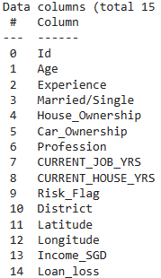
DATA FEATURES: INDEPENDENT
['Age’,
'Experience’,
'Married/Single’,
'House_Ownership’,
'Car_Ownership’,
'Profession’,
'CURRENT_JOB_YRS’,
'CURRENT_HOUSE_YRS’,
'District’, 'Latitude', 'Longitude’,
'Income_SGD’, ‘Loan_loss’]
'Risk_Flag',
87.7% Vs 12.3%
Modified to local Geography

Slide 10
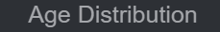
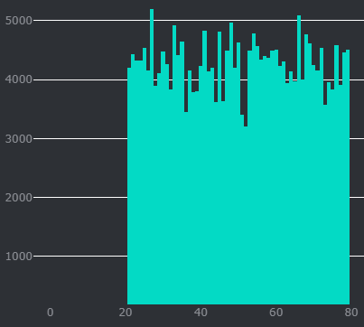
Observations/ Applicants
The applicants are between
20 years to 80 years.
Shows that all age groups want to get loans for their various financial needs in a similar way
Age

Slide 11
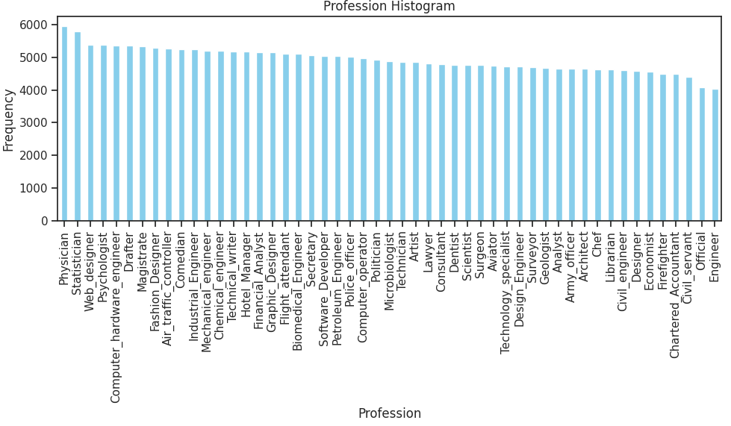
Predicting Customer Loan Defaults Using AI Algorithms
51 TYPES

Slide 12
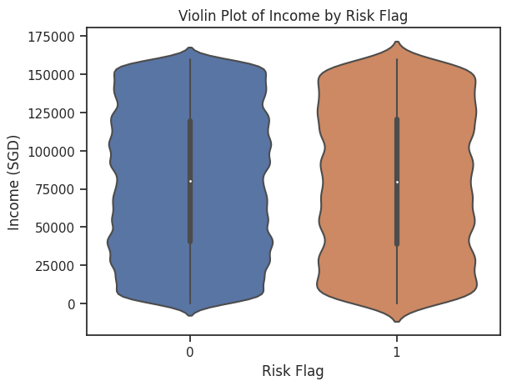
Predicting Customer Loan Defaults Using AI Algorithms
The income range of customers
Settled loans Vs. Defaulted
are similar……
Poor, Middle income, and Rich, HAVE PAID their loans (Risk Flag=0)
Customers who defaulted also are either Poor, Middle-income range or Rich (Risk Flag=1)

Slide 13
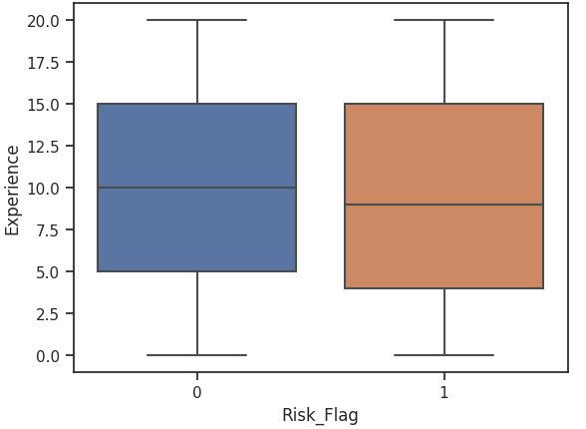
Predicting Customer Loan Defaults Using AI Algorithms
Loans settled Vs Loan Defaulted
50% of those who settled have work experience between 5-15 years
50% of those who defaulted have work experience between 4-15 years

Slide 14
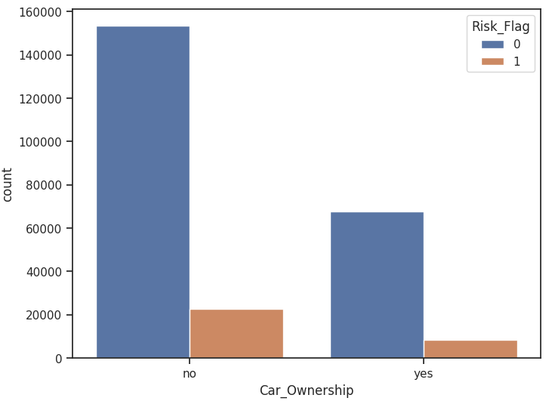
Predicting Customer Loan Defaults Using AI Algorithms
Loans settled Vs Loan Defaulted
150k customers without cars settled their loans and
20k customers without cars defaulted their loans
60k customers with cars settled their loans and
6k customers with cars defaulted their loans

Slide 15
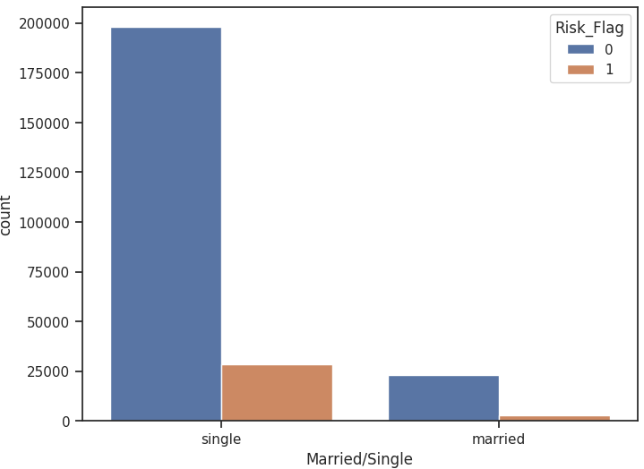
Predicting Customer Loan Defaults Using AI Algorithms
Loans settled Vs Loan Defaulted
195k singles settled their loans and
25k singles defaulted their loans
20k married, settled their loans and
3k married, defaulted their loans

Slide 16
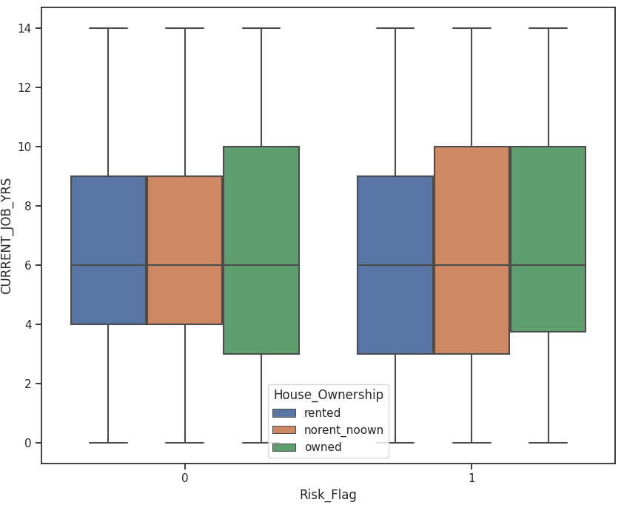
Predicting Customer Loan Defaults Using AI Algorithms
Loans settled Vs Loan Defaulted
50% of homeless people with current job experience between 4-9 years, settled their loans
50% of homeless people with current job experience between 3-10 years, defaulted their loans

Slide 17
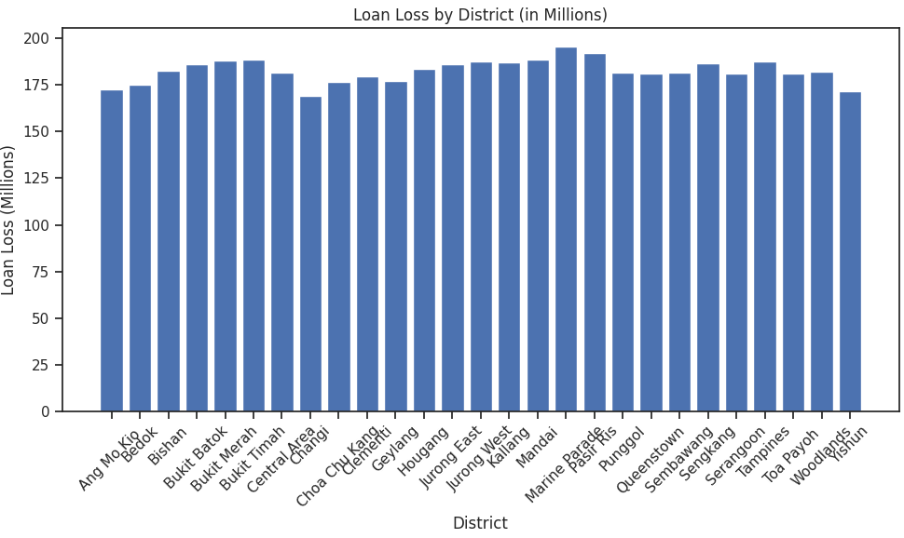

Slide 18
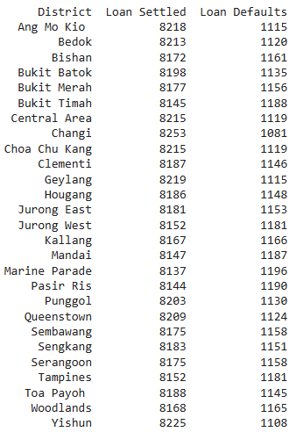
District wise Information

Slide 19

Sneak Peek
Singapore
Data on the Map
Shantanu Bank of Singapore

Slide 20
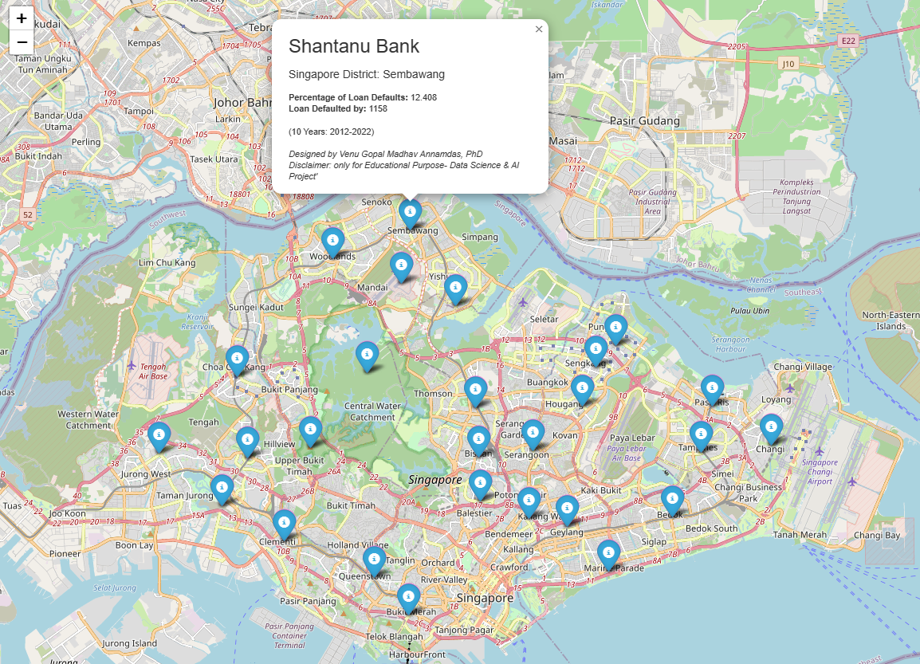
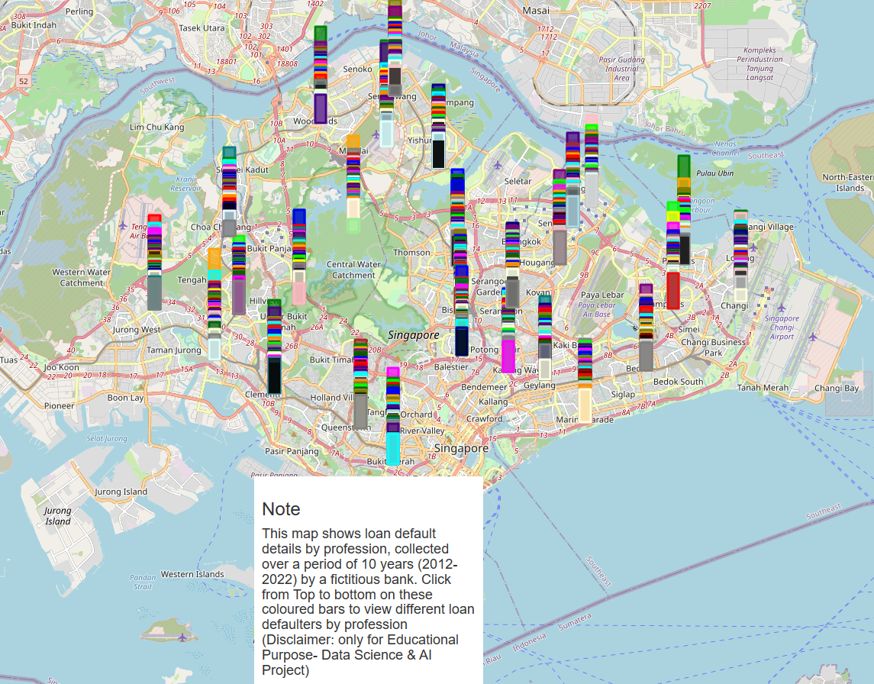
Data on the Map
raw.githack.com/venuannamdas/Singapore_Bank_Loan_Project/master/DataScience_AI_Banking_Project.html
raw.githack.com/venuannamdas/Singapore_Bank_Loan_Project/master/DataScience_AI_Banking_Project_Default_Details.html

Slide 21

Modeling

Slide 22
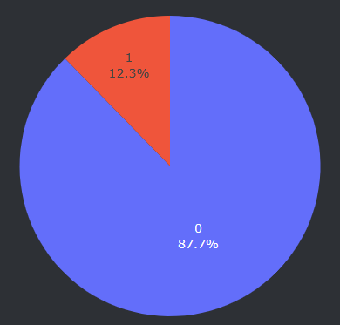
Data Preparation for Modelling
→Features in X , Target in y
X = df_bank[['Age', 'Experience', 'Married/Single', 'House_Ownership','Car_Ownership', 'CURRENT_JOB_YRS', 'CURRENT_HOUSE_YRS','Income_SGD’]]
y= df_bank['Risk_Flag']
Risk_Flag 0 221004 1 30996

Slide 23
AI Modelings adopted for Prediction
Decision Tree Modeling | 1. Class weights adopted 2. Hyperparameter Tuning -Reduced features -class weights adopted
Random Forest | CLASS WEIGHTS adopted
Principal Component Analysis | No class weights
Ensabled Method | Easy Ensemble for Imbalance class (Decision Tree)
Ensabled Method - | Easy Ensemble for Imbalance class-Hyperparameter tuning

Slide 24
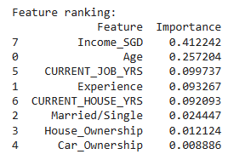
Decision Tree Modeling | 1. Class weights adopted

Slide 25
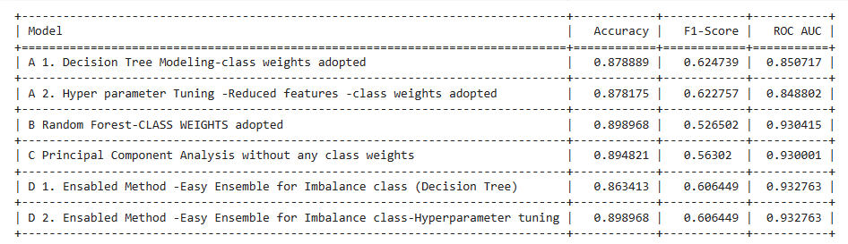

Slide 26
Conclusions
Project Goal
Business Solution
Predicting Customer Loan Defaults Using AI Algorithms
To Deploy system with ‘Prediction software’
Robust reliable loan default prediction system
→reduces financial risk →enhances its reputation
→competitiveness in the market.
Business Goal
Project Solution
Risk Mitigation
2. Improved Decision-Making:
3. Customer-Centric Approach: .
4.Cost Reduction:

Slide 27
FUTURE
….We can deploy the system in any financial institution

Slide 28
Thanks

